Slide 1















Analyzing the Student Engagement and Knowledge Retention based on Engaging and Traditional Teaching method
Krishna Sai Satvik Mukhe
Akshat Veerwal
Akshay Attri
Tarani Satya Kandula
Harshavardhan Gulla
Presented by
Group 11

Slide 2

Independent Variables:
Type of Teaching method (Traditional and Engaging)
Pre-requisite Knowledge on the domain (Yes or No)
Year of study (first year or senior)
Dependent Variables:
Retention Test (on a scale of 7)
Student Engagement (on a scale of 9)
Control Variables:
Only students of BITS pilani ,Pilani campus

Slide 3
Methodology
(Data Collection)
01
02
03
04
Respondents watched the video on topic “Neural Networks. (Traditional and Engaging)
Conducted an
in-person survey using Google form-
to collect the data.
Respondents took the Retention Test on the topic.
Respondents rated the teaching method of the video in terms of engagement.

Slide 4

TOOLS USED FOR DATA COLLECTION SURVEY
Engaging-teaching video link
Traditional-teaching video link
1)Neural Network In 5 Minutes | What Is A Neural Network? | How Neural Networks Work | Simplilearn (youtube.com)
1)Neural Network In 5 Minutes | What is a Neural Network? | How Neural Networks Work | NerdML (youtube.com)
Engaging video related questionnaire
Traditinal video related questionnaire
https://forms.gle/Z1ix62dZW8aYAp6k7
https://forms.gle/MEjQZcSnvY4PmzHF8

Slide 5






















Data collection

Slide 6


Data Cleaning
Timestamp
Email Address
BITS ID
Mobile Number
Gender
Which degree are you pursuing?
What is your specialization?
Which year of study are you currently in?
Do you have any prior knowledge about Machine Learning?
Student Retention Test (on a scale of 7)
Student Engagement Questionnaires (on a scale of 9)

Slide 7

Visualizing the Data after Data Cleaning & Preprocessing

Slide 8

Data Preprocessing Steps
Load data and libraries.
Selected columns required for ANOVA testing.
Checked for null values.
Renamed columns.
Converted Categorical values to Numerical Values.
Reordered the columns in Meaningful order.
Exported the final data into an Excel file.

Slide 9
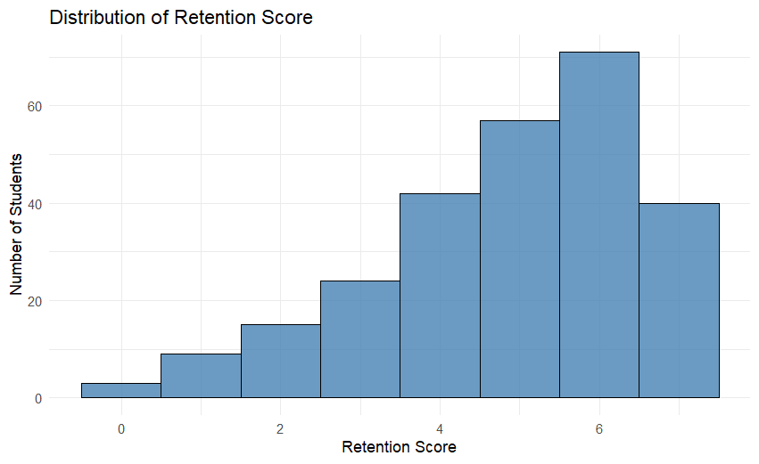
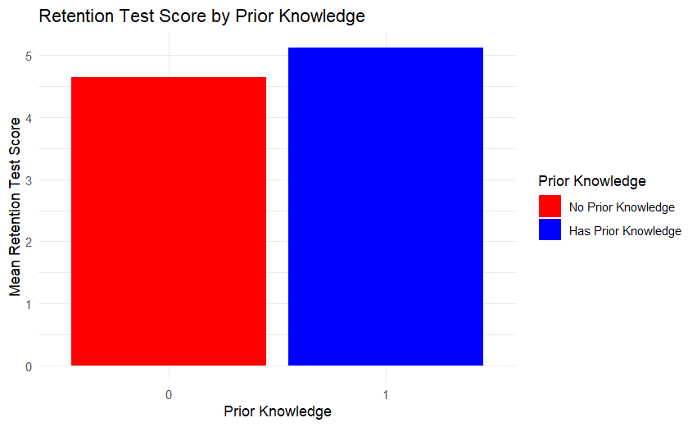
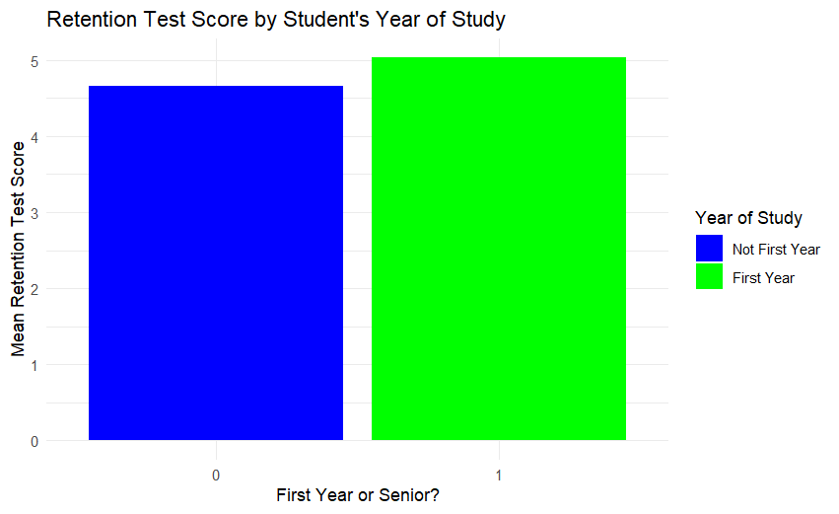
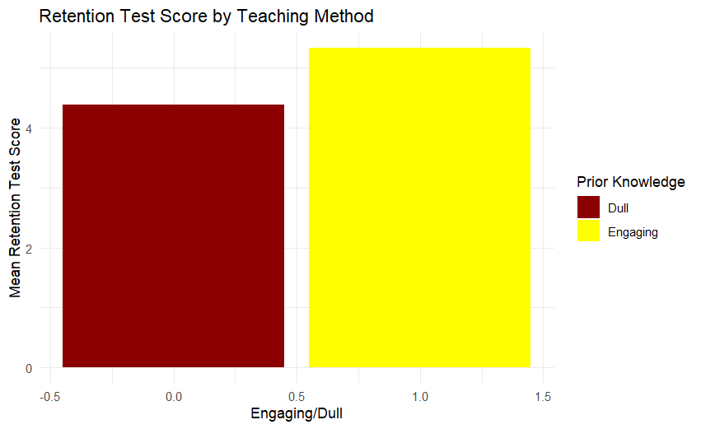
Insights from Cleaned Data - Retention Score (DV-1)

Slide 10
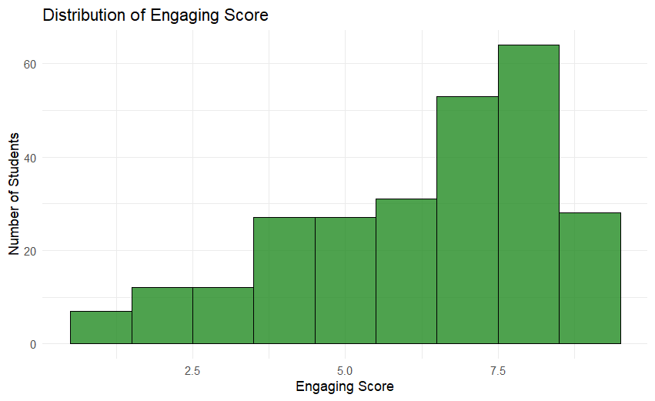
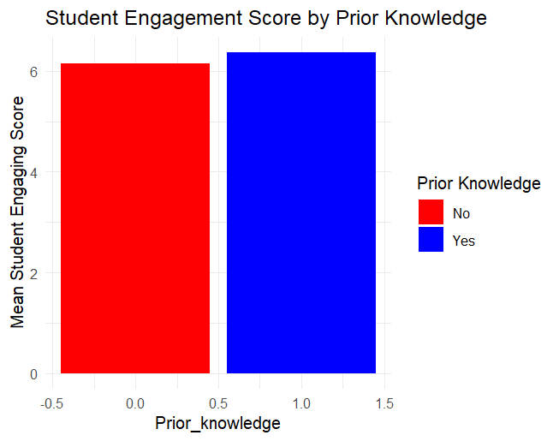
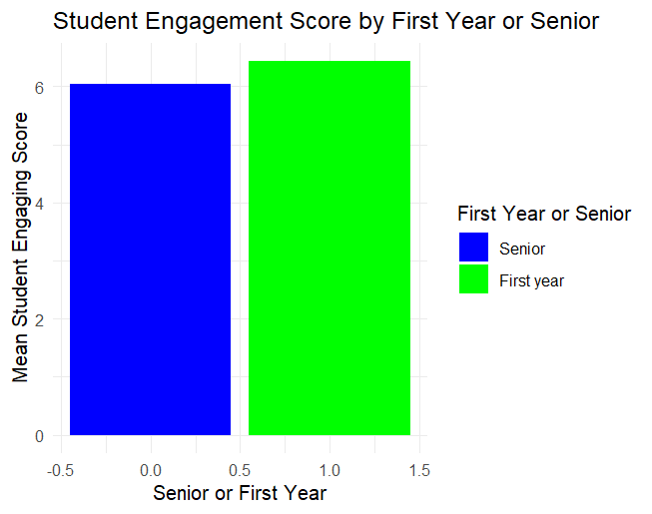
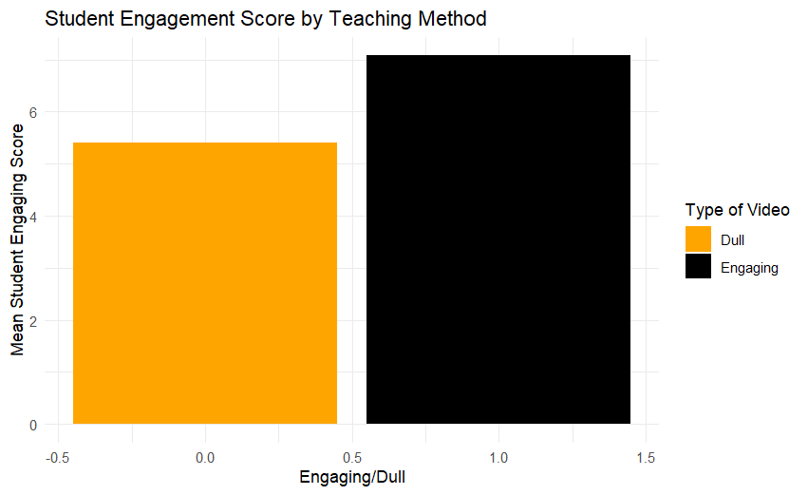
Insights from Cleaned Data - Engaging Score (DV-2)

Slide 11
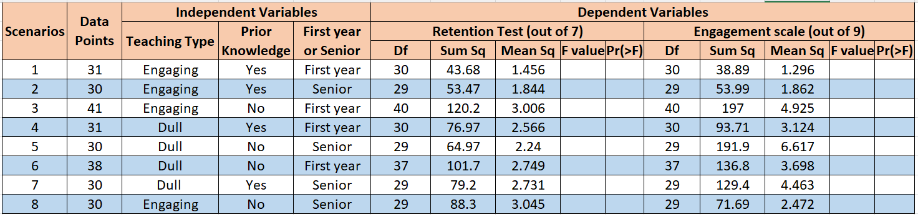
Analysis of Variance (ANOVA)
Summary of results for Each Scenario
Where Df is Degrees of Freedom
Sum Sq - Sum of Squares (Variance due to each factor)
Mean Sq - Mean of Squares (Average variance)
F-value - Test statistic to measure the variance between groups.
Pr(>F) - p-value indicating significance.

Slide 12
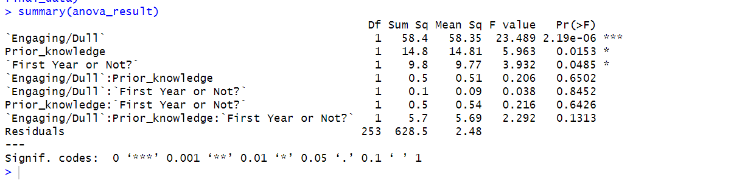
Analysis of Variance (ANOVA)
Summary of results for Retention Test Score (DV - 1)
1. The variable ‘Engaging/Dull’ has a highly significant effect on Retention_Score
(p-value = 2.19e-06 < 0.05) indicating that the Teaching Type strongly influences retention scores.
2. The variable Prior_knowledge is significant (p-value = 0.0153 < 0.05) suggesting that prior knowledge significantly influences retention scores independently.

Slide 13
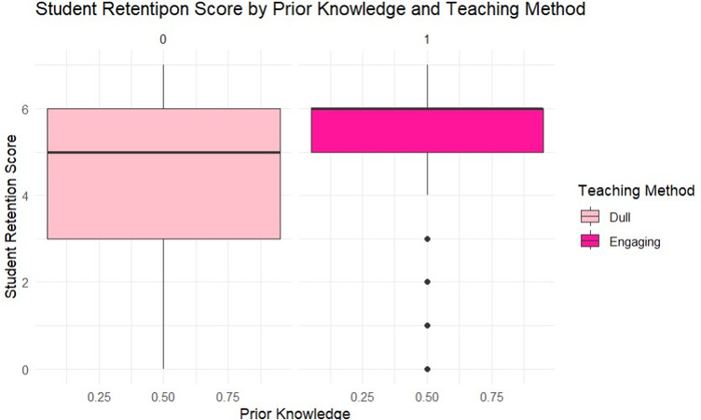
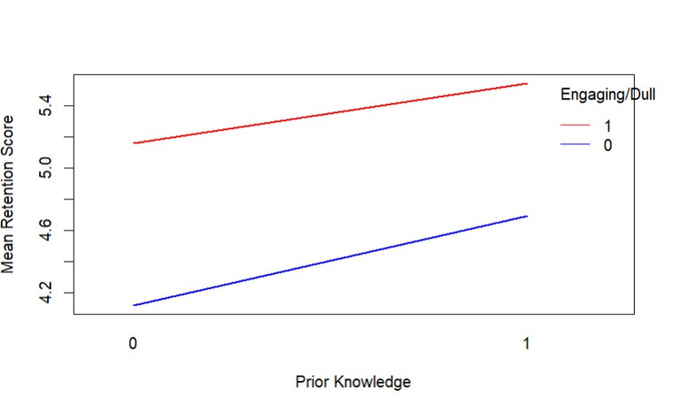
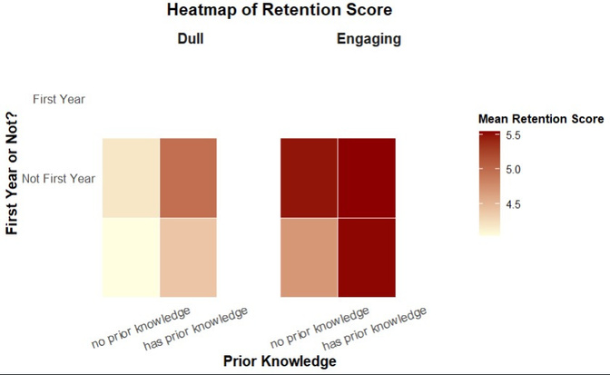
3. The variable First Year or Not? is significant (p-value = 0.0485 < 0.05) indicating that whether a student is in their first year or not impacts retention scores independently.
4. Interaction Effects:
None of the interaction effects (Engaging/Dull × Prior_knowledge, Engaging/Dull × First Year or Not?, Prior_knowledge × First Year or Not?, or the three-way interaction) are statistically significant (p-values > 0.05) implying that the independent effects of the variables on Retention_Score do not depend on their combinations.

Slide 14
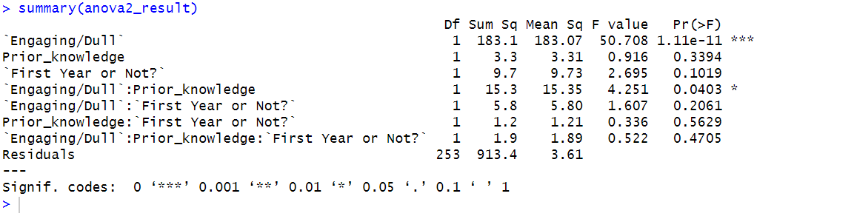
Analysis of Variance (ANOVA)
Summary of results for Student Engagement Score (DV - 2)
1. The variable Engaging/Dull has a highly significant effect on Student Engagement Score
(p-value = 1.11e-11 < 0.05) suggesting that teaching type plays a significant role in influencing student engagement scores.
2. The variable Prior_knowledge is not significant (p-value = 0.3394 > 0.05) indicating that prior knowledge does not significantly affect student engagement scores independently.

Slide 15
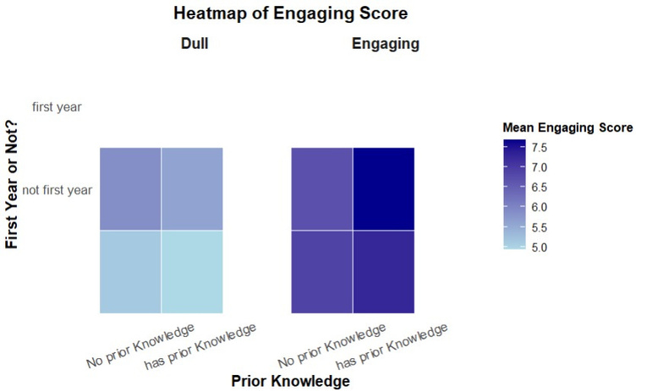
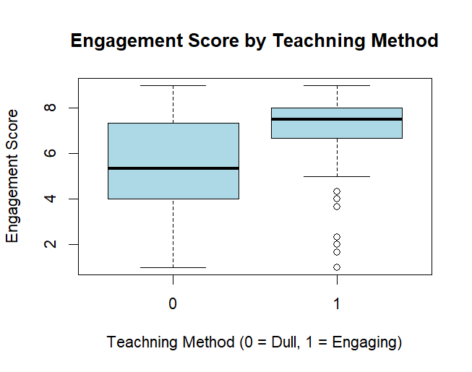
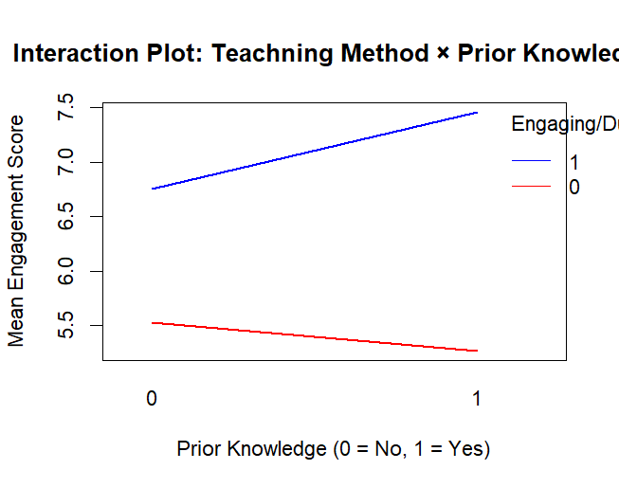
3. The variable First Year or Not? is not significant (p-value = 0.1019 > 0.05) indicating no significant effect on student engagement scores independently.
4. Interaction Effects:
The interaction between Teaching Type (Engaging/Dull) and Prior_knowledge is significant
(p-value = 0.0403) suggesting that the effect of whether the Teaching Type is engaging or dull
depends on the level of prior knowledge.
Other interactions (Engaging/Dull × First Year or Not?, Prior_knowledge × First Year or Not?, and the three-way interaction) are not significant.

Slide 16
CONCLUSION
FOR KNOWLEDGE RETENTION
Teaching Method has the strongest effect on Retention Score of the student on the subject.
Prior knowledge on the subject and Year of Study also have significant but smaller effects.
None of the interaction effects are significant, indicating that the independent variables affect Retention Score of the student on the subject independently, without combined effects.
2. FOR STUDENT ENGAGEMENT
Teaching Method is the only factor with a significant main effect on the Student Engagement on the teaching.
There is a significant two-way interaction between Teaching Method and Prior Knowledge, suggesting that the combined effect of these factors is important.
None of the other main effects or interactions has significant effect on Student Engagement on the teaching.

